Slide 1
Basic Photo Corrections
Intro to Photoshop

Slide 2
Chapter Objectives
Understand image resolution and size
Open and Edit an image Camera Raw
Adjust Tonal Range of an image
Straighten and Crop an image
Paint a color with Color Replacement
Adjust saturation using the Sponge Tool
Using the Clone Stamp to eliminate an unwanted part of an image
Use Spot Healing Brush tool to repair part of an image
Use content-aware fill to remove blemishes
Apply an Unsharp Mask filter to finish retouching photos

Slide 3
Resolution and Image Size
Resolution refers to the number of pixels (picture elements) along the width and height of an image.
Image Resolution is the number of pixels per unit of length in an image usually measured in pixels per inch (ppi).
Monitor Resolution is the number of pixels per unit of length on a monitor.
In Photoshop if the image resolution is higher than monitor resolution then the image will appear big and vice versa.

Slide 4
Camera Raw
Camera Raw allows you to prepare your pictures fresh from your cameras before working it on Photoshop.
Open your Adobe Bridge and then select an image and then right click then select Open in Camera Raw

Slide 5
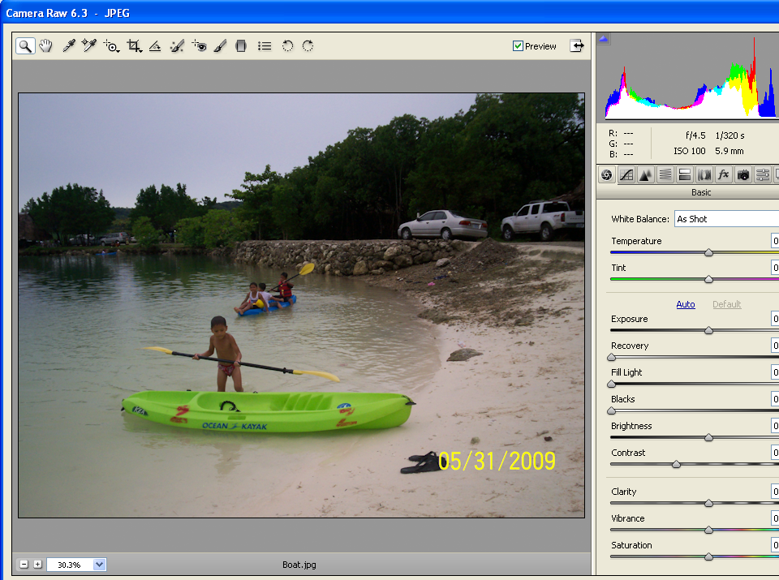
Camera Raw
You can adjust Exposure, Temperature, Tint, Brightness, Contrast etc in Camera Raw

Slide 6
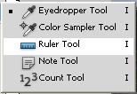
Ruler Tool
You can straighten your image using the Ruler Tool
Shortcut Keys
Keys | Description
I | Select Eyedropper wherein the Rule Tool is under with.
Ruler Tool

Slide 7
Color Replacement Tool
You can replace color on any part of your image using color replacement tool.
Shortcut Keys
Keys | Description
B | Selects Brush Tool wherein the Color Replacement Tool is under with.
Color Replacement Tool

Slide 8
Sponge Tool
Allows you to change the saturation by adjusting its strength or purity.
Shortcut Keys
Keys | Description
O | Selects Dodge Tool wherein the Sponge Tool is under with.
Sponge Tool

Slide 9
Clone Stamp Tool
Allows you to copy or clone an area of an image to replace another part of an image.
Shortcut Keys
Keys | Description
S | Selects Clone Stamp Tool.
Clone Stamp Tool
In order to Clone part of your image you need to select an area to clone first by pressing Alt key then click with your mouse the area you want to clone. Afterwards just click on the desired area where the clone will appear.

Slide 10
Spot Healing Brush Tool
Allows you to quickly removes blemishes and other imperfections in your photos.
Shortcut Keys
Keys | Description
J | Selects Spot Healing Brush Tool.
Spot Healing
Brush Tool
Drag the mouse in the area you want to apply Spot Healing.

Slide 11
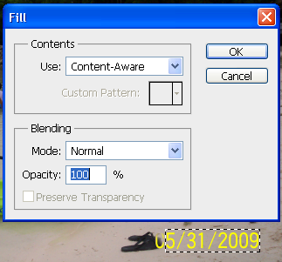
Content Aware Fill Tool
Allows you to fills a selection that matches its surroundings. Its very good removing an object in image that you don’t want to be there.
Make the selection first then click Edit→Fill and the dialog box below will appear. Select then Use Content-Aware and press Ok.

Slide 12
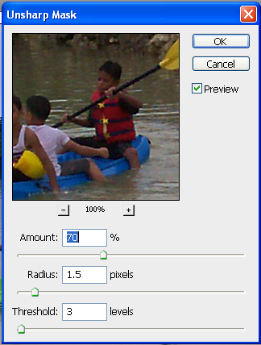
Unsharp Mask Filter
Allows you to adjusts the contrast of the edge detail and creates the illusion of a more focused image.
Click Filter→Sharpen→Unsharp Mask and the dialog box below will appear.

